Slide 1
CSE 3100: Systems Programming
Part 2
Lecture 2: More on Processes
Professor Kaleel Mahmood
Department of Computer Science and Engineering
University of Connecticut

Slide 2
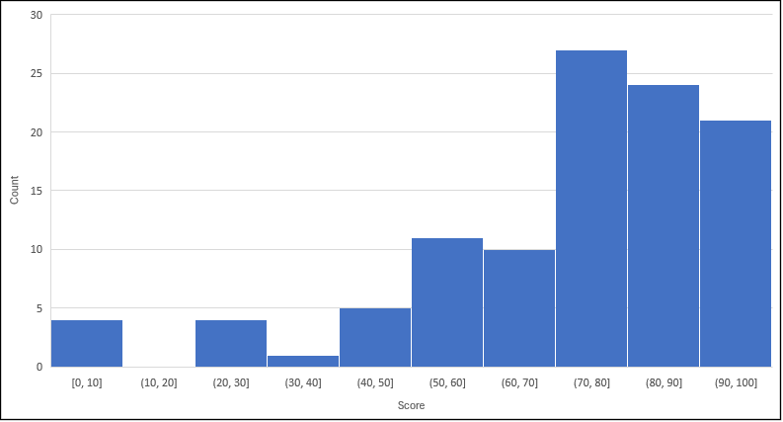
Exam 1 Grades
Average: 72.66
Median: 78

Slide 3
Exam 1 Grades
This is an extremely challenging course.
Keep studying hard and trying!
For any grade related or exam related questions please see your TA first as they were the ones who graded the exam.
If you are not satisfied with their feedback AFTER talking to the TA, then come to me.

Slide 4
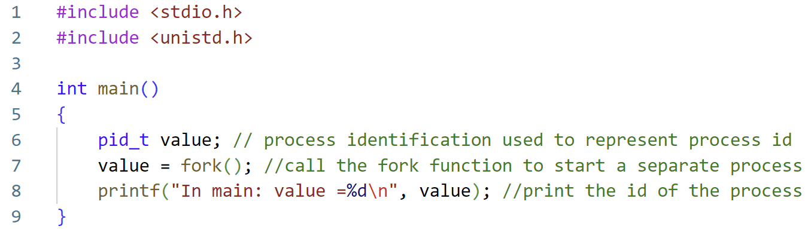
Review From Last Lecture (1)
We discussed the idea of processes and the fork function to create multiple processes.
When fork is called in the parent code, a child is created which is a clone of the parent. The child starts running AFTER the line where the fork function was called.

Slide 5
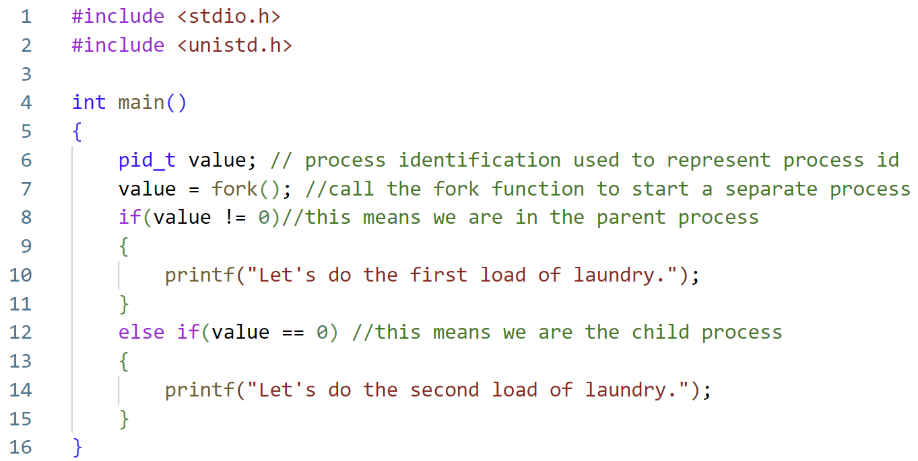
Review From Last Lecture (2)
When we create processes, we usually do so with the goal of making each process run some DIFFERENT piece of code.
Essentially, we want processes to run in parallel.
How did we make the parent and child run different tasks? Using the process ID.

Slide 6
Review From Last Lecture (3)
How to keep track of children and parents if you want to call fork multiple times?
Short Answer: It is not pretty.
Parent Process
Child A
Child B
Child C

Slide 7
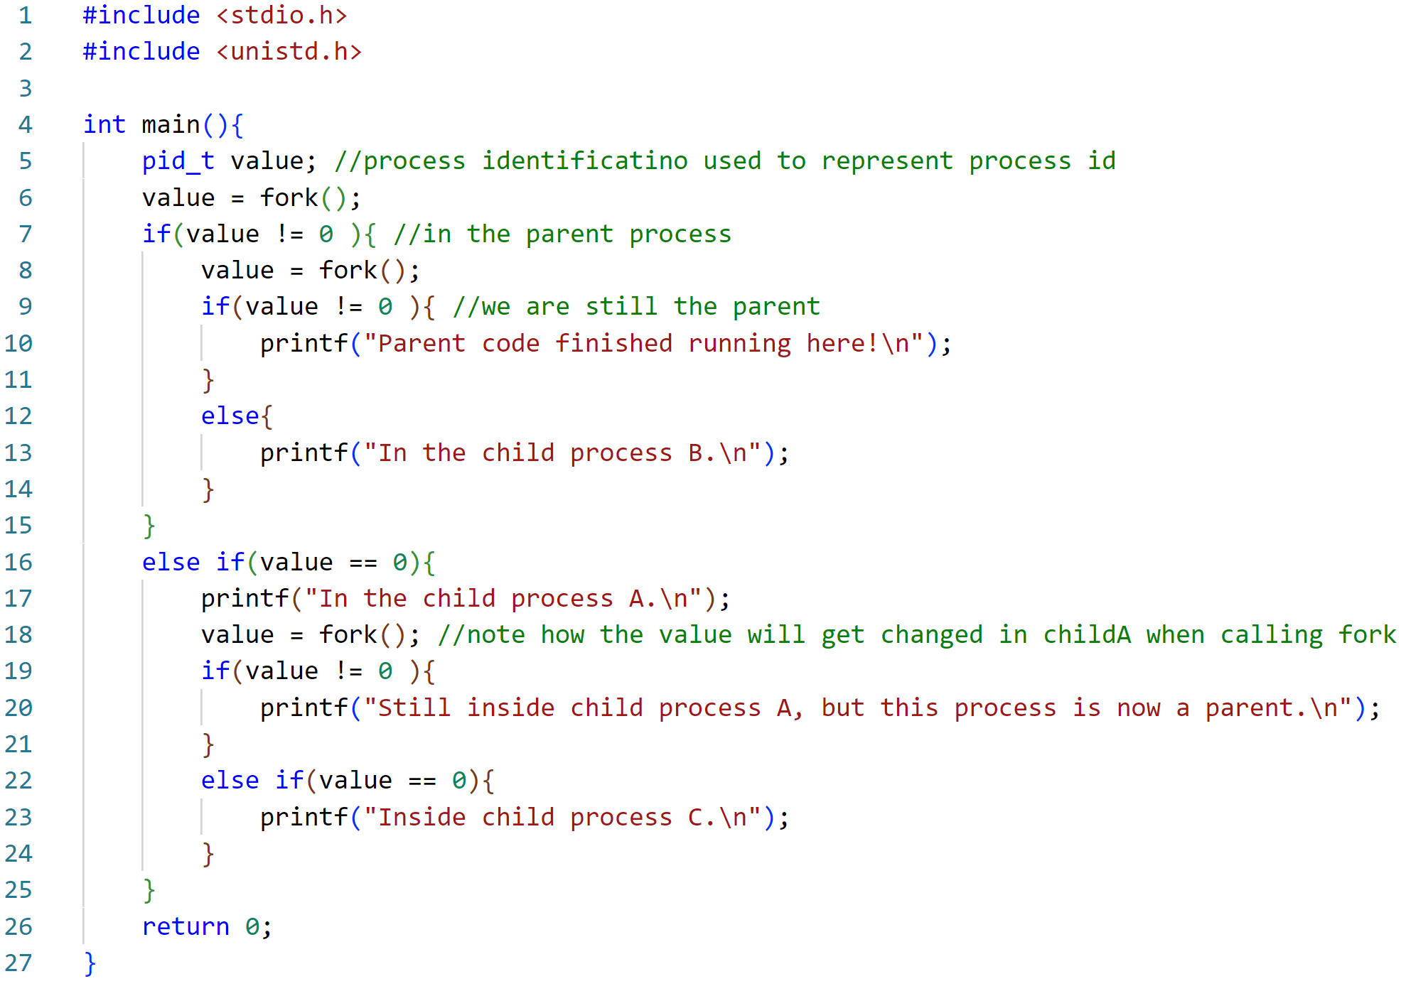
How to keep track of children and parents if you want to call fork multiple times?
Short Answer: It is not pretty.

Slide 8
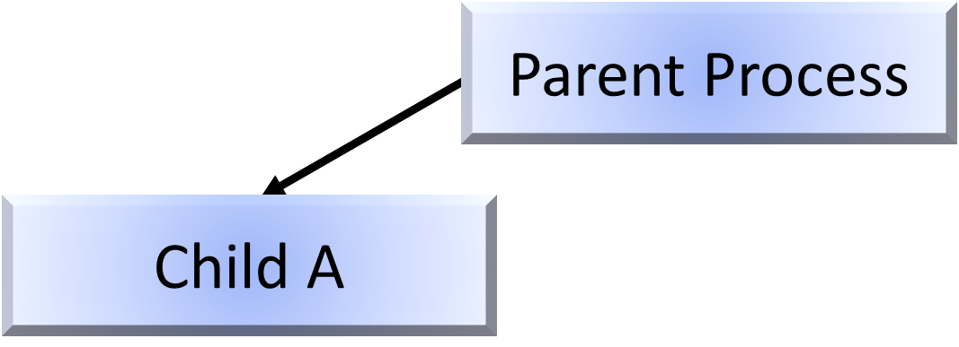
How to keep track of children and parents if you want to call fork multiple times?
We are here

Slide 9
How to keep track of children and parents if you want to call fork multiple times?
We are here

Slide 10
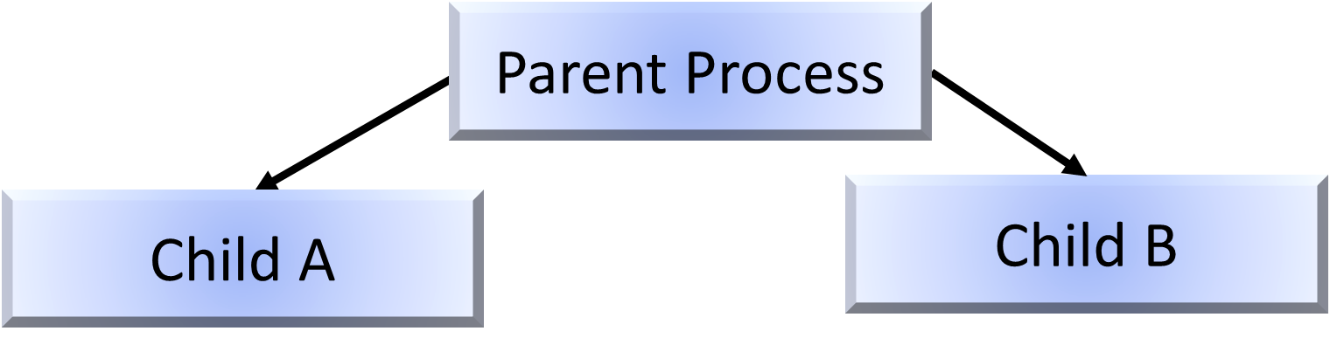
How to keep track of children and parents if you want to call fork multiple times?
We are here

Slide 11
How to keep track of children and parents if you want to call fork multiple times?
We are here

Slide 12
How to keep track of children and parents if you want to call fork multiple times?
We are here

Slide 13
How to keep track of children and parents if you want to call fork multiple times?
We are here

Slide 14
How to keep track of children and parents if you want to call fork multiple times?
We are here

Slide 15
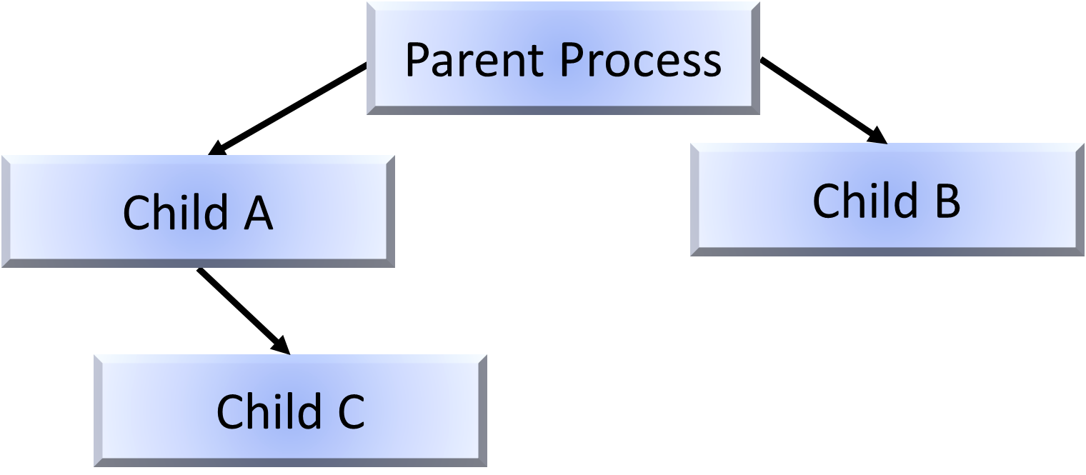
How to keep track of children and parents if you want to call fork multiple times?
We are here

Slide 16
How to keep track of children and parents if you want to call fork multiple times?
We are here

Slide 17
How to keep track of children and parents if you want to call fork multiple times?
We are here

Slide 18

Complete Solution
One more question: could the solution be further improved upon?

Slide 19
Question: What if we want the child do run some code that is not contained within the original file?
Run some piece of code that is in a different file.

Slide 20
We’ll Explain This in Three Pieces:
First: Let’s look at a separate piece of simple code.
Second: How can we run the code without forking?
Third: Run the code WITH forking

Slide 21
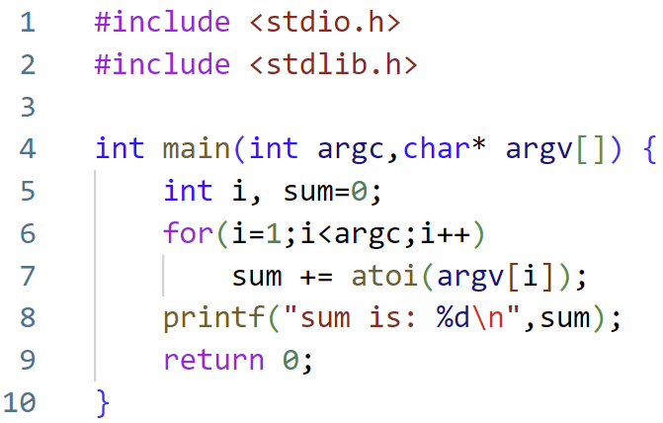
First: Let’s look at a separate piece of simple code.
adder.c

Slide 22
First: Let’s look at a separate piece of simple code.
Number of arguments being passed.
adder.c
List of numbers to add together, can be any length.
Numbers are input as strings from the command line.

Slide 23
First: Let’s look at a separate piece of simple code.
adder.c
Convert the string numbers to integer data types.
Add the numbers to together.
Print the result.

Slide 24
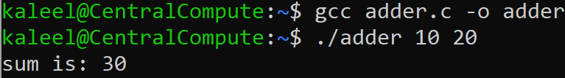
Second: How can we run the code without forking?

Slide 25
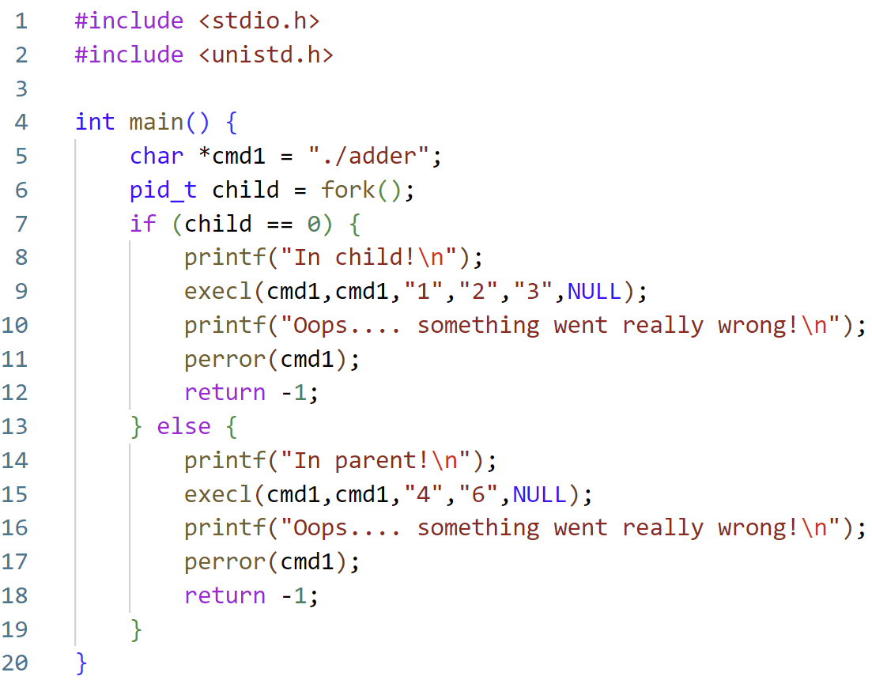
Third: Run the code WITH forking

Slide 26
Third: Run the code WITH forking
Immediately call the fork function to create two copies of the code.

Slide 27
Third: Run the code WITH forking
This is the command to execute commands OUTSIDE of the main code.

Slide 28
Third: Run the code WITH forking
Do some basic error handling.

Slide 29
What does this look like in practice?

Slide 30
What does this look like in practice?

Slide 31
What does this look like in practice?
Parent Process (child variable has non-zero value)
Child Process (child variable has 0 value)

Slide 32
What does this look like in practice?
Parent Process (child variable has non-zero value)
Child Process (child variable has 0 value)
In the parent we will go to line 13 and start executing code.
In the child we will go to line 8 and start executing code.

Slide 33
What does this look like in practice?
Parent Process (child variable has non-zero value)
Child Process (child variable has 0 value)
At line 15 we’ll go into a new code and execute. Its important to note, we DO NOT return.
At line 9 we’ll go into a new code and execute. Its important to note, we DO NOT return.

Slide 34
What does this look like in practice?
Parent Process (child variable has non-zero value)
Child Process (child variable has 0 value)
At line 15 we’ll go into a new code and execute. Its important to note, we DO NOT return.
At line 9 we’ll go into a new code and execute. Its important to note, we DO NOT return.
We’ll get 4+6, which should print 10.
We’ll get 1+2+3, which should print 6.

Slide 35
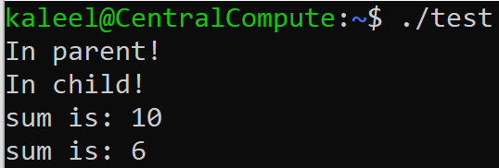
What does this look like in practice?
For this example, where were the files such that they could be accessed?

Slide 36
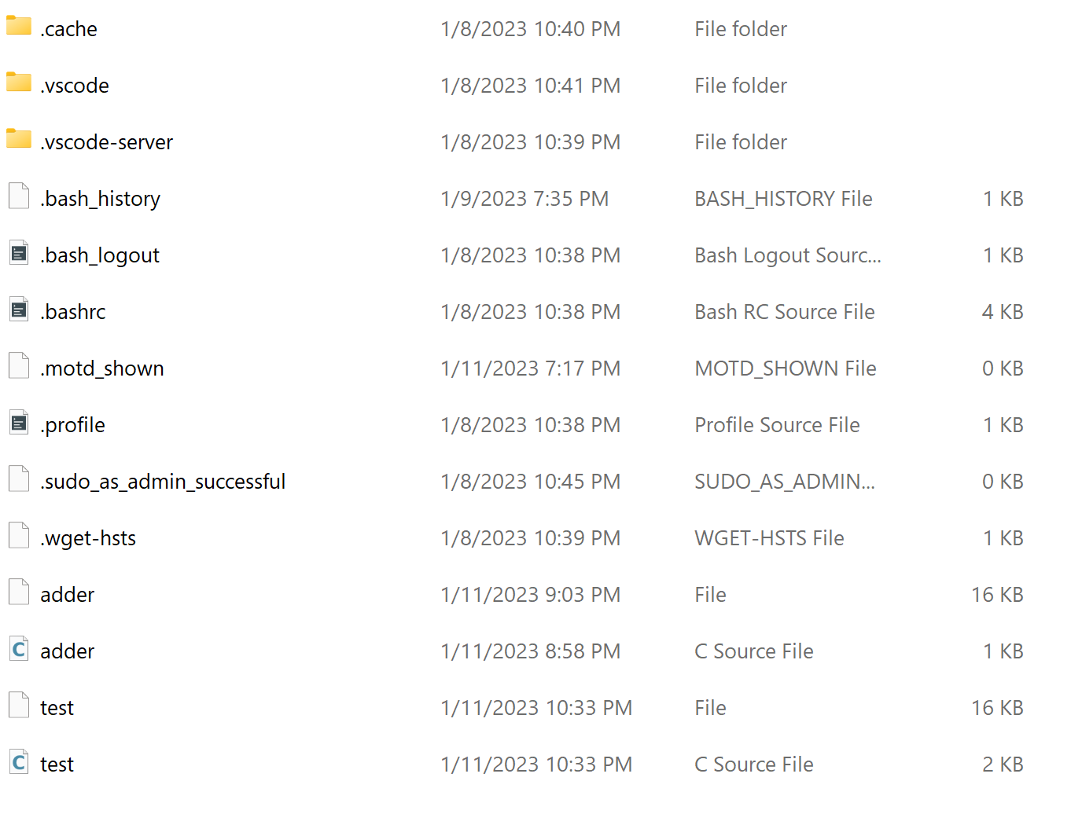
Where were the files such that they could be accessed?
adder.c
Main Ubuntu Directory (using Windows Subsystem Linux)
test.c

Slide 37

Process upgrades
Usually….
A fresh clone wants to run different code
This is done by
Loading another executable into the process address space
[picked up from the file system of course]
Note
Opened files are NOT AFFECTED by the upgrade operation

Slide 38

The exec family
The act of ‘upgrading’ is done by the child with a system call
Many variants. "man -S3 execl" for all details
#include <unistd.h>
int execl(const char *path, const char *arg0, ... /*, (char *) NULL */ );
The path to the executable to load inside our own address space
A list of arguments to be passed to the new executable
A final NULL pointer to give the “end of argument list”
If successful, execl() does not return! Started a new process
Basically any call to Execl:

Slide 39
How is the executable found?
Specify a path, like /bin/ls
Specify a file, and the system searches in directories listed in PATH
echo $PATH in bash to see directories separated by ':'
int execl(const char *path, const char *arg0, ...
/*, (char *) NULL */ );
// execlp() searches paths for file
int execlp(const char *file, const char *arg0, ...
/*, (char *) NULL */ );

Slide 40
The exec family 2
// If the number of arguments is unknown at compile time
#include <unistd.h>
int execv(const char *path, char *const argv[]);
int execvp(const char *file, char *const argv[]);
The arguments in execl in are placed in an array
argv is the argv you see in the main function!
execv needs a path while execvp can search file in PATH
Start a new process if successful. Similar to execl

Slide 41
A small note on: argv to execv and execvp
$gcc –o ab ab.c
"ab.c"
NULL
argv[3]
argv[2]
argv[1]
argv[0]
"ab"
argv
"-o"
"gcc"
Note that the last value in argv is null? Why?
So that the code knows where to stop reading.

Slide 42
Common Errors in Writing Forking Code (Example 1)
pid_t pid = fork();
if (pid < 0) {
perror("fork()"); exit(1); // exit if fork() fails
} else if (pid == 0) {
child_tasks();
} else {
parent_tasks();
}
more_parent_tasks();
What is wrong with this code?

Slide 43
Example 1: Consider the child process
pid_t pid = fork();
if (pid < 0) {
perror("fork()"); exit(1); // exit if fork() fails
} else if (pid == 0) {
child_tasks();
} else {
parent_tasks();
}
more_parent_tasks();

Slide 44
Example 1: Consider the child process
pid_t pid = fork();
if (pid < 0) {
perror("fork()"); exit(1); // exit if fork() fails
} else if (pid == 0) {
child_tasks();
} else {
parent_tasks();
}
more_parent_tasks();

Slide 45
Example 1: Consider the child process
pid_t pid = fork();
if (pid < 0) {
perror("fork()"); exit(1); // exit if fork() fails
} else if (pid == 0) {
child_tasks();
} else {
parent_tasks();
}
more_parent_tasks();

Slide 46
Example 1: Consider the child process
pid_t pid = fork();
if (pid < 0) {
perror("fork()"); exit(1); // exit if fork() fails
} else if (pid == 0) {
child_tasks();
} else {
parent_tasks();
}
more_parent_tasks();
Visualization of the Child Process when you ask it to mow the lawn:

Slide 47
Example 1: Corrected Code
pid_t pid = fork();
if (pid < 0) {
perror("fork()"); exit(1); // exit if fork() fails
} else if (pid == 0) {
child_tasks();
exit(0); // terminate the child process
} else {
parent_tasks();
}
more_parent_tasks();

Slide 48
Example 2: What could go wrong?
pid_t pid = fork();
if (pid < 0) {
perror("fork()"); exit(1); // exit if fork() fails
}
else if (pid == 0) {
// in child process
execlp("genie", "genie", "clean the house", NULL);
}
// in parent process
online_shopping();
Would you ever know if execlp failed?

Slide 49
Example 2: Corrected Code
pid_t pid = fork();
if (pid < 0) {
perror("fork()"); exit(1); // exit if fork() fails
}
else if (pid == 0) {
// in child process
execlp("genie", "genie", "clean the house", NULL);
printf(“Something went really wrong in child process!\n");
}
// in parent process
online_shopping();

Slide 50
File APIs (API = Application Programming Interface)
Remember the (C standard library) IO APIs
The “f” family (fopen,fclose, fread, fgetc, fscanf, fprintf,…)
All these use a FILE* abstraction to represent a file
Additional features: user-space buffering, line-ending translation, formatted I/O, etc.
UNIX has lower-level APIs for file handling
Directly mapped to system calls
open, close, read, …
Use file descriptors [which are just integers]
Deal with bytes only

Slide 51
Some low level file APIs
Read the man pages (man –s2 …) for more functions
#include <sys/types.h>
#include <sys/stat.h>
#include <fcntl.h>
#include <unistd.h>
int open(const char *path, int oflag);
int open(const char *path, int oflag, int mode);
int close(int fd);
ssize_t read(int fd, void *buf, size_t nbyte);
ssize_t write(int fd, const void *buf, size_t nbyte);
off_t lseek(int fd, off_t offset, int whence);

Slide 52
How to open a file
#include <fcntl.h>
#include <unistd.h>
int open(const char *path, int oflag);
Parameters
path: the path to the file to be opened/created
oflag: read, write, or read and write, and more (on the next slide)
The function returns a file descriptor, a small, nonnegative integer
Return -1 on error

Slide 53
Flags in open()
Must include one of the following: O_RDONLY (read only), O_WRONLY (write only), or O_RDWR (read and write)
And or-ed (|) with many optional flags, for example,
O_TRUNC: Truncate the file (remove existing contents) if opening a file for write
O_CREAT: Create a file if it does not exist.
Example:
// remember open() returns -1 on error
fd1 = open("a.txt", O_RDONLY); // open for read
fd1 = open("a.txt", O_RDWR); // open for read and write
fd1 = open("a.txt", O_RDWR|O_TRUNC); // read, write, truncate the file

Slide 54
Creating a file with open()
// a mode must be provided if O_CREAT or O_TMPFILE is set
int open(const char *path, int oflag, int mode);
mode: specify permissions when a new, or temporary, file is created.
open("b.txt", O_WRONLY|O_TRUNC|O_CREAT, 0600);
// open b.txt for write. If the file exists, clear (truncate) the contents.
// if the file does not exist, create one, and set the permission so that the owner of the file can read and write, but other people cannot.

Slide 55



File descriptors
A file descriptor is a nonnegative integer associated with a file.
#include <stdio.h>
int fileno(FILE *stream);
// returns a file descriptor for a stream
FD | FILE *
0 | stdin
1 | stdout
2 | stderr
The input, for example the process takes inputs from the keyboard.
Where the process gives outputs e.g. the terminal.
Where the process reports errors, e.g. could be a log file recording the errors.

Slide 56
File descriptors after fork and exec
Opened files are NOT AFFECTED by the upgrade operation
pid_t pid = fork();
assert(pid >= 0);
if (pid == 0) {
// Child process can access FDs 0, 1, and 2
// if execl() is successful, gcc can access FDs 0, 1, and 2
execlp("gcc", "gcc", "a.c", NULL);
// If control gets here, execlp() failed.
// Remember to terminate the child process!
return 1;
}

Slide 57
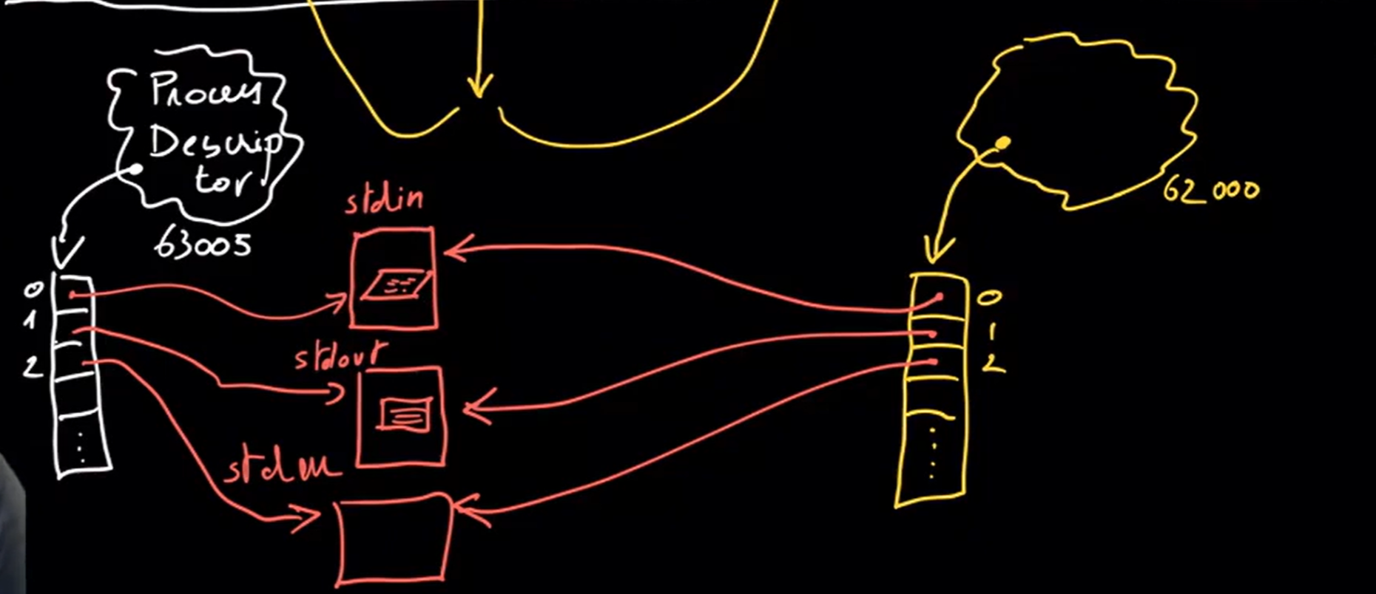
Visualization of File Descriptor with Fork
The Parent Process
The Child Process
Figure Source: Professor Laurent Michel Youtube Lecture Videos

Slide 58

Preview of the future
CSE 3100
You already know that child processes copy the variables from the parent code.
It follows that the file descriptors are also copied over to the child.
So why all the focus on file descriptors? This will come in handy in the future when we want processes to communicate with each other.

Slide 59
Figure Sources
https://i.kym-cdn.com/entries/icons/facebook/000/019/404/upgradddd.jpg
https://www.mememaker.net/static/images/memes/4761591.jpg
https://thumbs.gfycat.com/HollowPositiveAnophelesmosquito-max-1mb.gif
https://iconarchive.com/download/i87838/icons8/ios7/Computer-Hardware-Keyboard.ico
https://icons.iconarchive.com/icons/paomedia/small-n-flat/1024/terminal-icon.png
https://cdn-icons-png.flaticon.com/512/1388/1388902.png
https://static.seekingalpha.com/uploads/2013/3/21/7360901-13638972437431467-Robert-Wagner.jpg

